Slide 1

David Moreno
Mario Raushel
Terence Sin
Caleb Wells

Slide 2
Contents

Slide 3
Background
Problem
Create log of your daily movement
Visualize day through captured images
Needs
There is a need for users to autonomously create and explore daily photo life logs for both a fun and interesting experience.
Goal
The goal for this project is to create a wearable camera system capable of recording GPS data that will automatically record the daily life of the user based on a variety of triggers, and organize data.

Slide 4
Requirements
The prototype design should cost no more than $500
The prototype must be battery powered and capable of logging a 12 hour session
The camera unit should not cause any harm to the user or others
The camera should function well both indoors and outdoors

Slide 5
Requirements
The GPS should function well in outdoor urban areas and have a decent failover for loss of signal indoors
The design must be comfortable to wear and lightweight (< 1 lb)
Accompanying software must be easy to use and understand
The camera unit must take good quality pictures (at least 320 x 240 resolution)

Slide 6
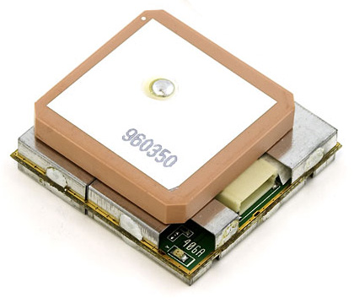
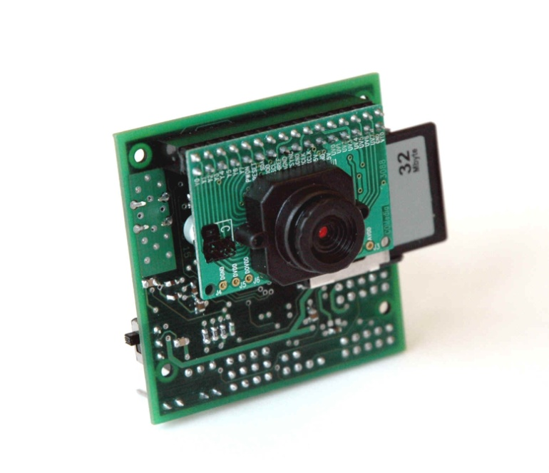
Components
GPS
EM-406A SiRF III Receiver
Camera
CMUCam3

Slide 7
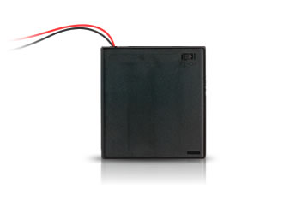
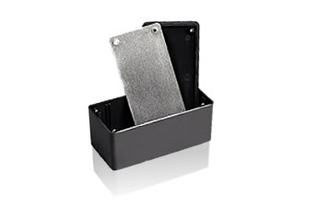
Components
Power
4AA Batteries
Enclosure
5x2.5x2 Project Box

Slide 8
Enclosure Design

Slide 9
Design Alternatives
GPS
Trimble Copernicus
SiRF II
Enclosure Designs
Custom Acrylic
Aluminum Project Box
Web Services
Flickr

Slide 10
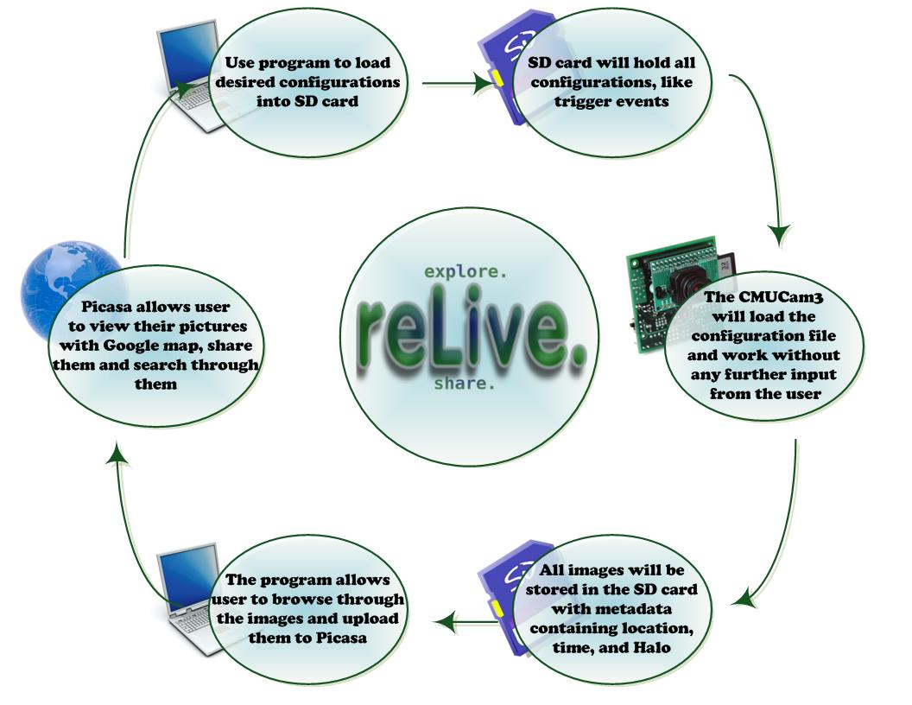
System level Description

Slide 11
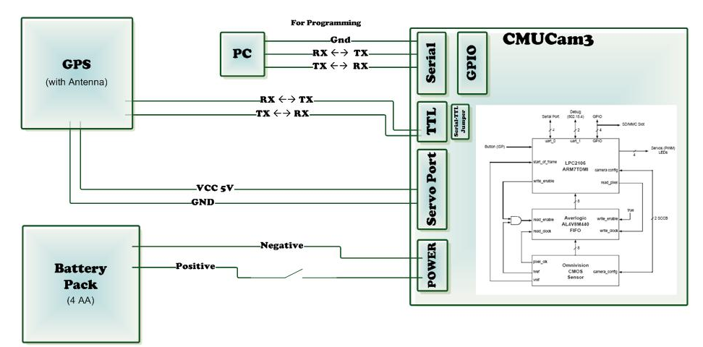
Hardware Design

Slide 12
Trigger Settings
Time Delay (Minutes) - The amount of time the camera must wait between each picture taken
Minimum Distance - The distance a user must travel before another picture is taken.
Scheduler – Times during which pictures should be taken.
Location Halo - The center and radius of a halo where pictures must be taken.

Slide 13
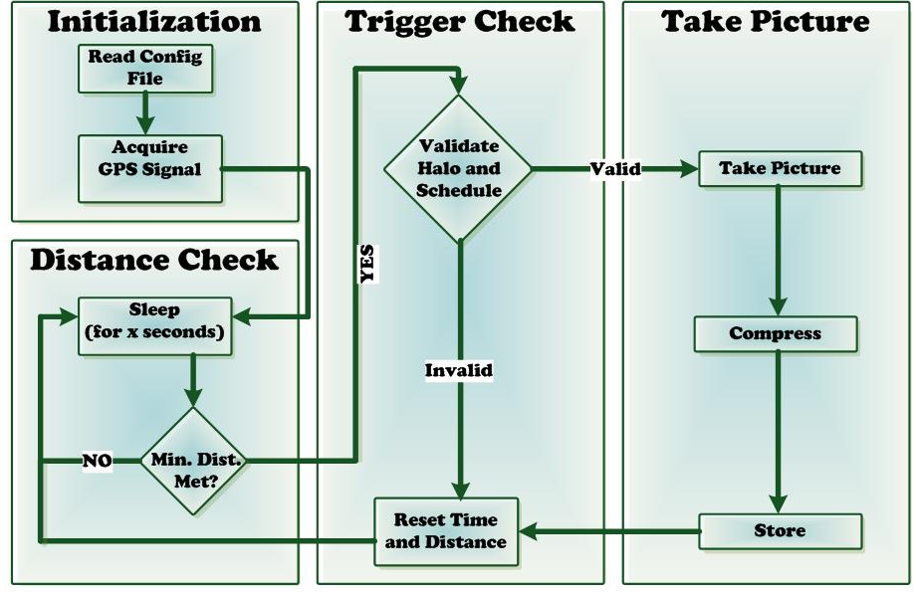
CMUCam3 Program Design

Slide 14
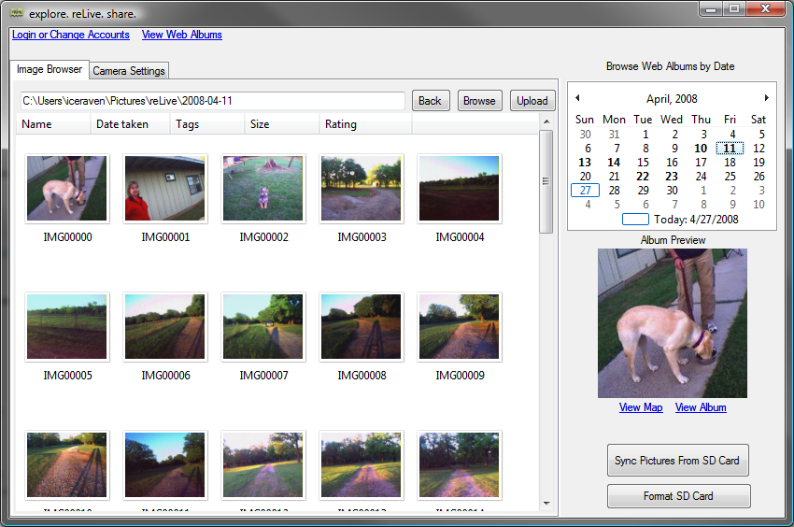
Software Design

Slide 15
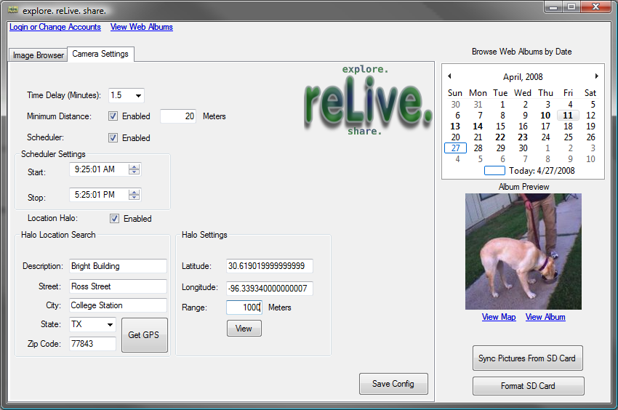
Software Design

Slide 16
Team Management
David Moreno
Hardware and CMUCam3 operations
Purchasing
Mario Raushel
Software design and implementation
Terence Sin
Software and hardware interaction design
Caleb Wells
Leader
Hardware and GPS operations

Slide 17

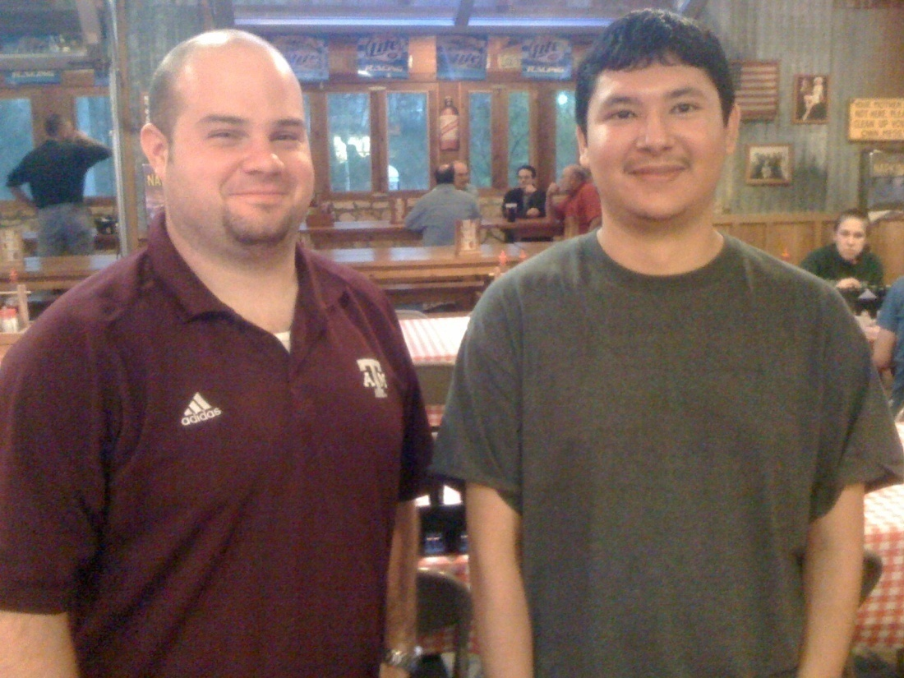
Effective Teamwork
2-3 meetings each week to discuss updates and plans
Constant email communication providing individual progress reports
Team building activities such as meeting at Rudy’s for dinner
Overcame problems as a team

Slide 18
Societal, Safety, Political, and Environmental Analysis
Societal Analysis
For privacy concerns the camera must be large enough that others can tell they are being photographed
Safety Analysis
One of our key objectives is to create a camera unit that will not cause any harm to the user
Political Analysis
Upon purchase user must agree it will not be used for malicious reasons.
Environmental Analysis
Will be supplied with rechargeable batteries
Lead free device

Slide 19
Manufacturability, Sustainability and Economics
Manufacturability
Hardware easily mass produced
Software easily distributed
Sustainability
Batteries can be recharged
Information synchronized to both computer and Google
Economics
Low bulk material cost

Slide 20
Final Product
Budget
Evaluation

Slide 21
Overview

Slide 22
Any Questions?

